Slide 1

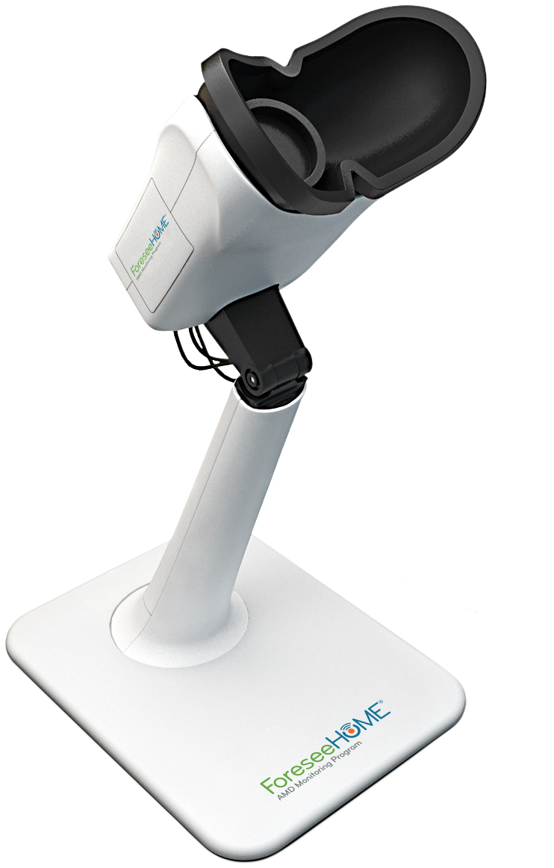

Little to no out-of-pocket costs for the majority of Medicare patients
FDA Cleared
Medicare Covered
$0
for the majority of Medicare patients
Patients with Medicare and a secondary supplement plan could have out-of-pocket costs as low as $0 per month
$15.03
per month*
For patients without supplemental insurance
Patients with Medicare and no secondary supplement plan will pay $15.03 per month once their $185 yearly Medicare Fee-for-Service Part B deductible is met*
*Does not apply to patients enrolled in Medicare Advantage Plans.
Patient Financial Assistance Program is available for qualifying patients
1 | Patient Financial Services
SM-032.02
Notes:
Key Message: ForeseeHome delivers advanced, at-home disease detection. Here’s how.

