Slide 1

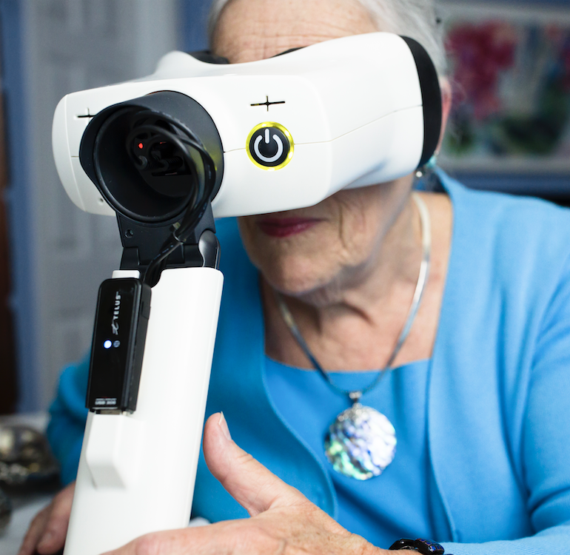
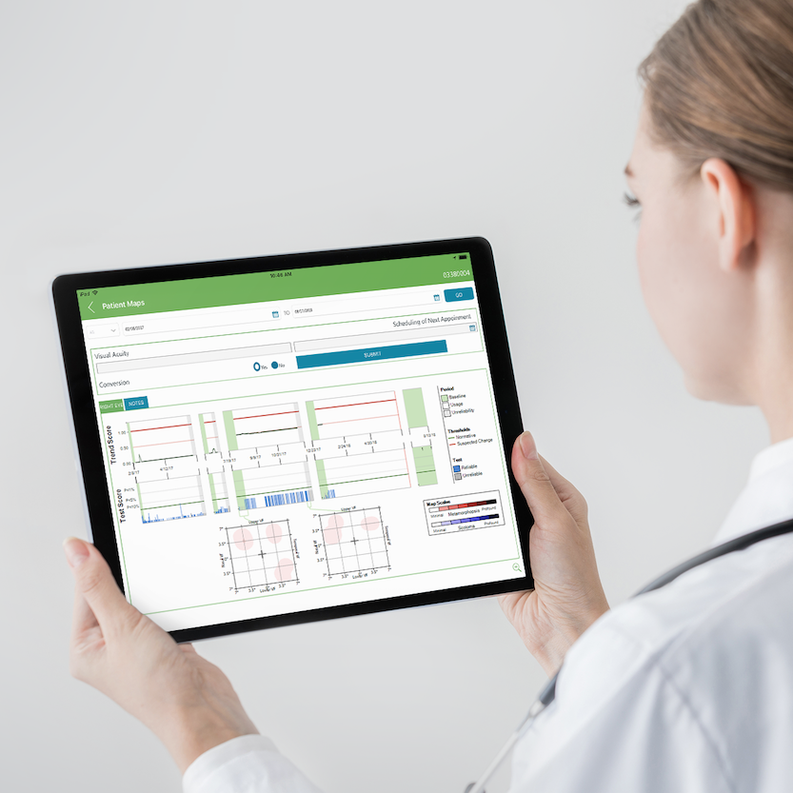

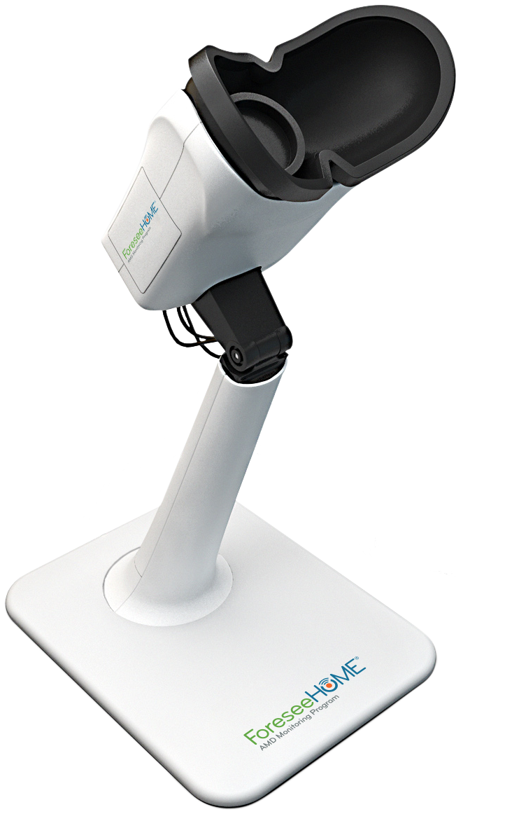


Setup and daily tests are quick and easy
1
2
3
Turn the device on
Turn on the device and look into the viewfinder to begin testing
Take an easy test in just a few minutes per day
A bump will briefly appear and then disappear. Use the mouse provided to click where the bump appeared and return to the center dot
Your results are sent
Data from each test is sent to Notal Vision for evaluation and then provided to the eye doctor
You control how alerts are managed
1 | ForeseeHome Test: How does it work?
SM-021.01
Notes:
Key Message: ForeseeHome delivers advanced, at-home disease detection. Here’s how.

Slide 2
