Slide 1



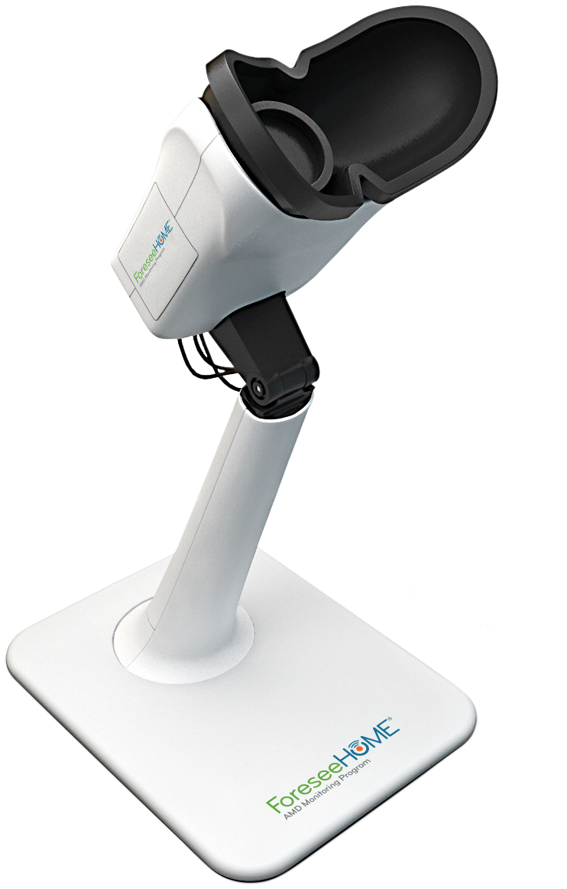

Introduce ForeseeHome® and we’ll take it from there
A ForeseeHome Clinical Partner will be with your patients every step of the setup process
Education & Verification
After receiving a prescription, patients will receive a call to answer any questions, verify coverage, and ship their device
Setup & Training
Once the device is received, patients are walked through setup and training
Ongoing Feedback
Patients will continue to receive feedback through the ForeseeHome Patient Portal or App
No obligations. The set-up process can be cancelled at any time.
SM-020.01
Notes:
Key Message: Our new patient onboarding process is simple and provides best-in-class high-frequency patient monitoring. Introduce your patients to ForeseeHome and we will do the rest.

