Slide 1


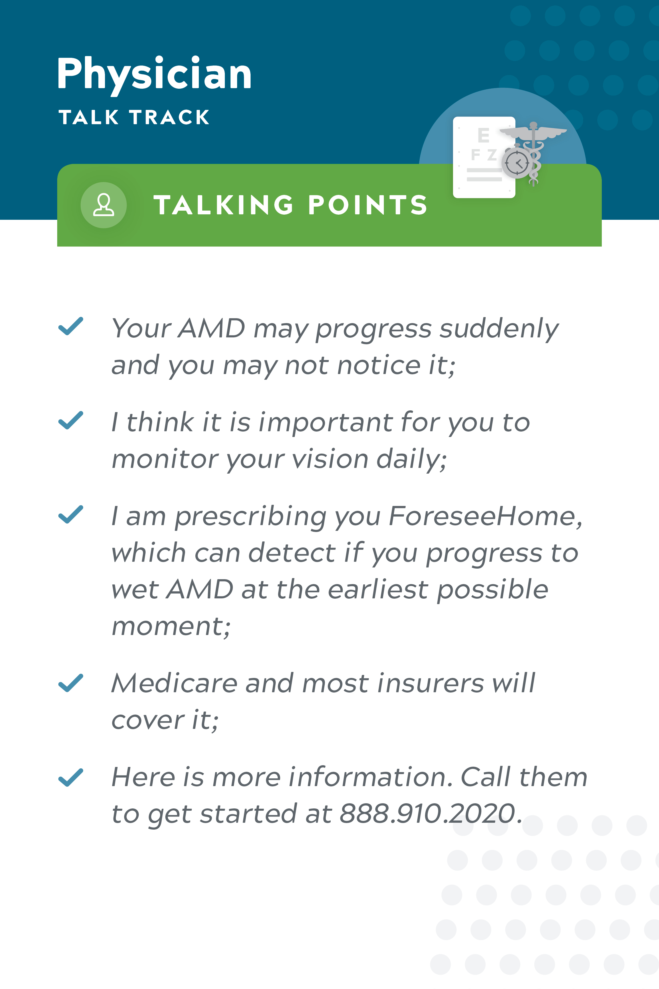
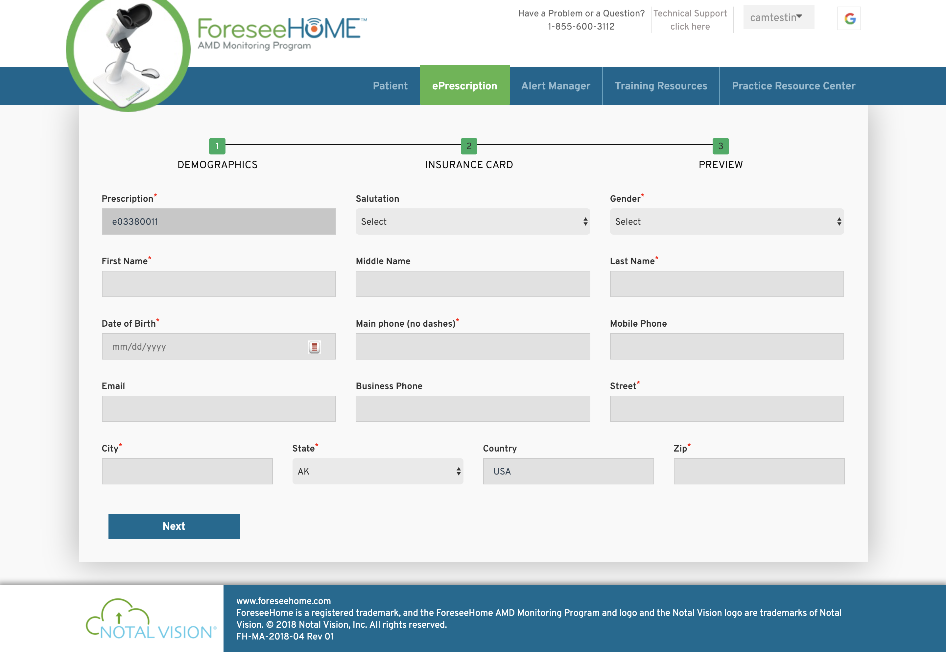
Prescribe & Go: 30s Track
1
2
GIVE PATIENT KIT
3
SUBMIT R_{X}
1 | Prescribe and go: PERSONALIZED R_{X} EXPERIENCE
SM-018.01
Notes:
Key Message: Prescribing is simple and easy once we incorporate our best practices and resources into your clinic.

Slide 2


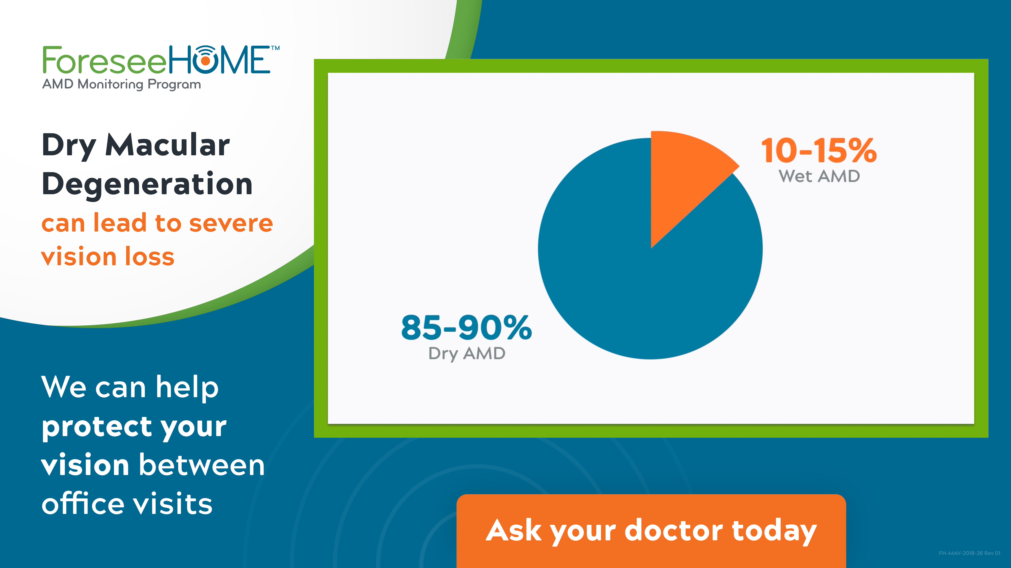
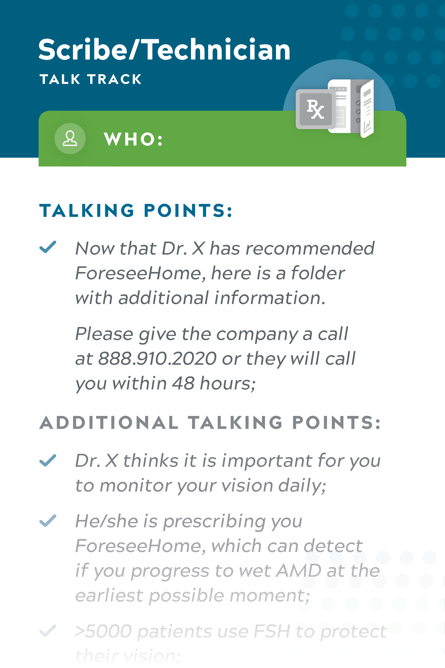
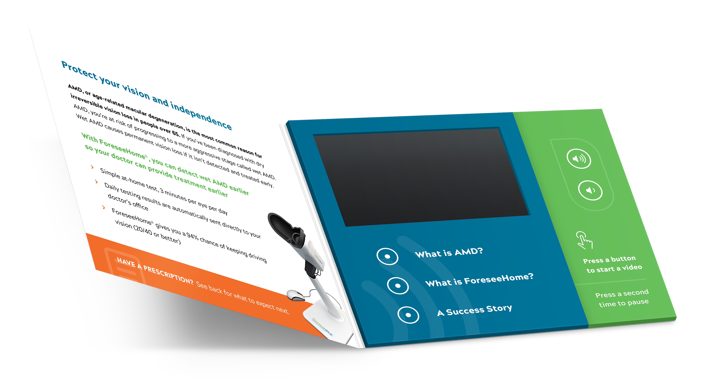
Prescribe & Go: Expanded Track
EDUCATE ON AMD
IN THE WAITING AND EXAM ROOM
REINFORCE WITH TECH SUPPORT
AND PATIENT ED
1
3
RX FORSEEHOME AND HAND
PATIENT KIT
SUBMIT R_{X}
2
4
2 | Prescribe and go: PERSONALIZED R_{X} EXPERIENCE
SM-018.01
Notes:
Key Message: Prescribing is simple and easy once we incorporate our best practices and resources into your clinic.

