Slide 1




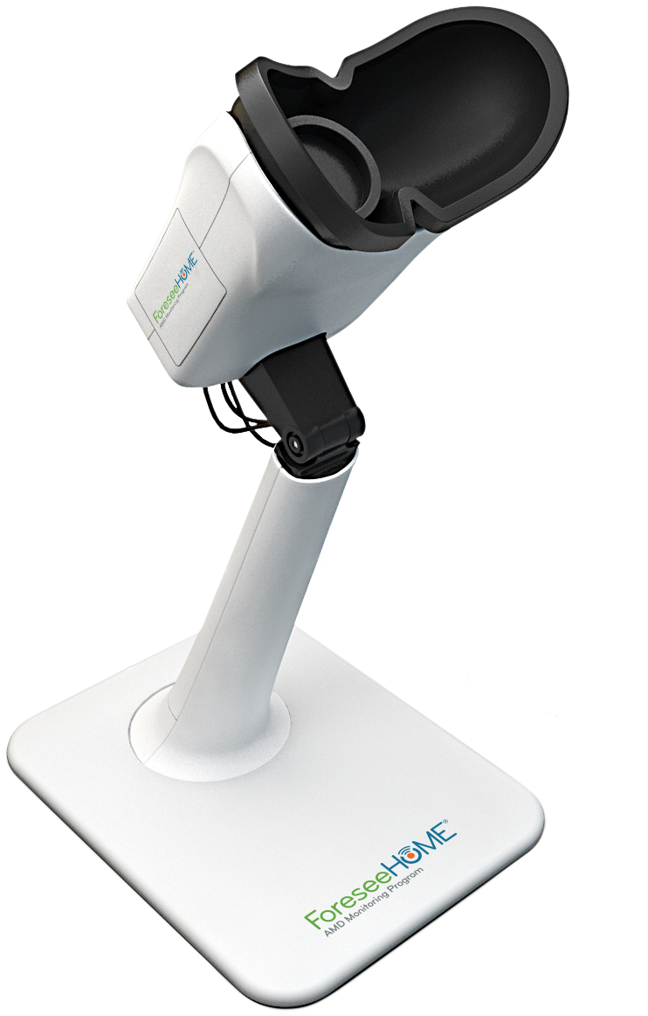

Prescribing is simple and easy once we incorporate our best practices and resources into your clinic
1
2
3
Complete
The ForeseeHome Practice Form
We will provide
In-office and take-home patient education
We will help
Implement a simple process to identify and educate patients
1 | ForeseeHome Practice Onboarding
SM-017.01
Notes:
Key Message: Prescribing is simple and easy once we incorporate our best practices and resources into your clinic.

