Slide 1
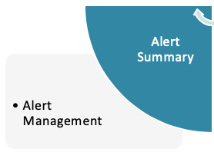
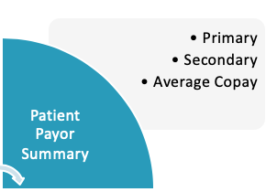
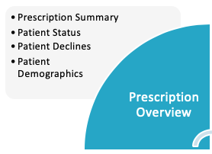
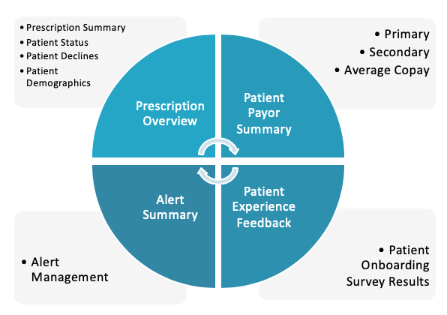
NSM Cheat sheet: The recipe and ingredients for driving depth of prescribing
Strengthen belief in clinical benefit
Make FSH easy to prescribe
Keep FSH top of mind
Generate positive feedback loop
Aid identifying right patient
Medicare Coverage
INCREASED DEPTH OF RXing
Strengthen belief in clinical benefit
Business
Review
MSL
Patient Stories
The Evolution of Home Diagnostics
Patient Financial Services
ForeseeHome Practice Onboarding
ForeseeHome Patient Candidate?
Elevating the Clinical Benefit
Notal Vision in the News
Mini-modules
New and Improved Patient Experience
ForeseeHome Test: How does it work?
Prescribe and Go
ForeseeHome Prescribing Options
ForeseeHome Patient
Onboarding

